Slide 1


Project Osoleth:
Streamlining Client Message Requests
Ravens of House Suisse
Shreyas Urdhwareshe, Cynthia Dong, Anahi Mayancela

Slide 2




1
Agenda
Problem
Steps
Solution
Conclusions

Slide 3

The Problem:
Response Time

Slide 4
Daenerys Targaryen sends message ravens across Westeros to check on her investments with her banker, Tycho Nestoris, of the Iron Bank of Braavos...
3
Unfortunately, if Tycho doesn’t respond with information on her investments in a timely manner, Dany sends Drogon to speed things up...

Slide 5
In real terms, sometimes clients on Bloomberg Chat want information on their investments, but when this information isn’t centralized and easy-to-access, the Credit Sales Desk can’t respond in a timely manner.
4
Clients don’t usually have dragons, but it’s still important to keep them happy!

Slide 6
Steps

Slide 7
6
How We Did It:
-----------------
Used Java to process the data from the chats and store RFX data in a searchable manner. Linked the back end to the front end with via a RESTful API.

Slide 8
7
Process
Map RFX Sales Data in a searchable form
Extract client data from IB Chat in the correct IB Chat Format
Create a front-end that simulates the Bloomberg Chat
Use the ISIN values from within the chat to search RFX Sales Data
Front-end displays the ISIN data

Slide 9
8
Backend Specifics
Data Structure Reasonings
ISINValues Class
Filtering With Regex
Notes:
For reference in Appendxi
LL vs array vs Map
ISINValues acts as wrapper around an array in essence

Slide 10
9
Flow of Information
Chat Simulated via Excel Spreadsheet
Java: Converts Excel to JSON in IB Chat formatting
Java: Processes JSON information and uses a regular expression to filter out ISIN values
Java: Maps RFX Sales Data in a searchable format and looks up investment info based on the ISIN
RESTful API hosts data
Front end: Ajax queries back end for ISIN values
Front-end saves info and sends the ISIN to the back end
Front end displays investment information

Slide 11
Our Solution
Presenting our demo

Slide 12
Conclusions

Slide 13
12
Time Constraint Conflicts
Frontend and Backend Integration
Using NLP libraries
Notes:
NLP: understand what is being requested and give back a adaquete response

Slide 14

Questions?

Slide 15
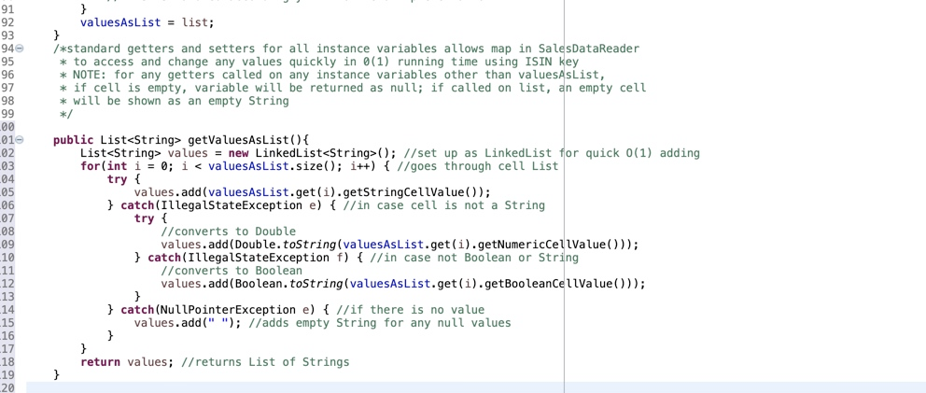
Appendix A: Code

Slide 16
